Slide 1
Design and analysis of algorithms
19AIE212 - Project Presentation

Slide 2
TABLE OF CONTENTS
01
02
03
Shell sort
Tree sort
Heap Sort
Analysing the time complexities of all these different sorting algorithms considering the best, average and worst cases.

Slide 3
Genetic algorithm
04
Using the Genetic Algorithm to solve the Travelling Salesman Problem

Slide 4
01
SHELL SORT

Slide 5
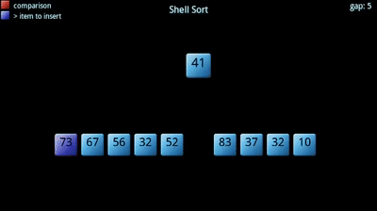
SHELL SORT
In this Algorithm, we compare elements that are a distance apart rather than adjacent
We calculate “gap” for each pass and then select the elements towards the right of gap and sort them

Slide 6
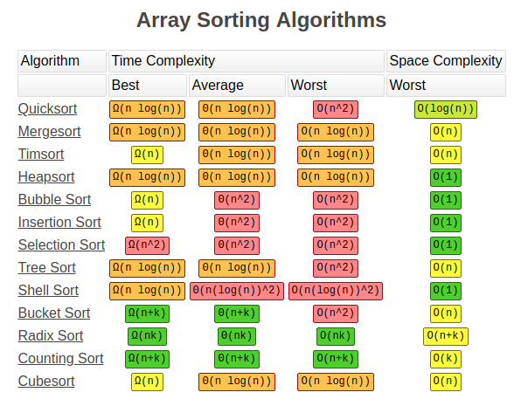
ALGORITHM
Initialize the gap size
Divide the array into subarrays of equal gap size
Apply insertion sort on the subarrays
Gap is updated to gap/2
Repeat the above steps until the gap size becomes 0 resulting into a sorted array

Slide 7
WORKING
12
34
54
2
3

Slide 8
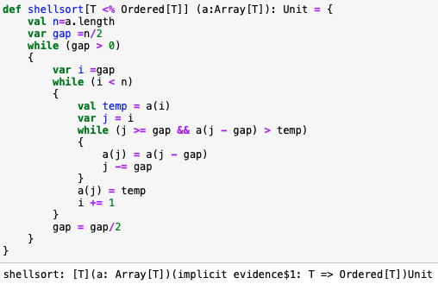
Shell sort Code

Slide 9
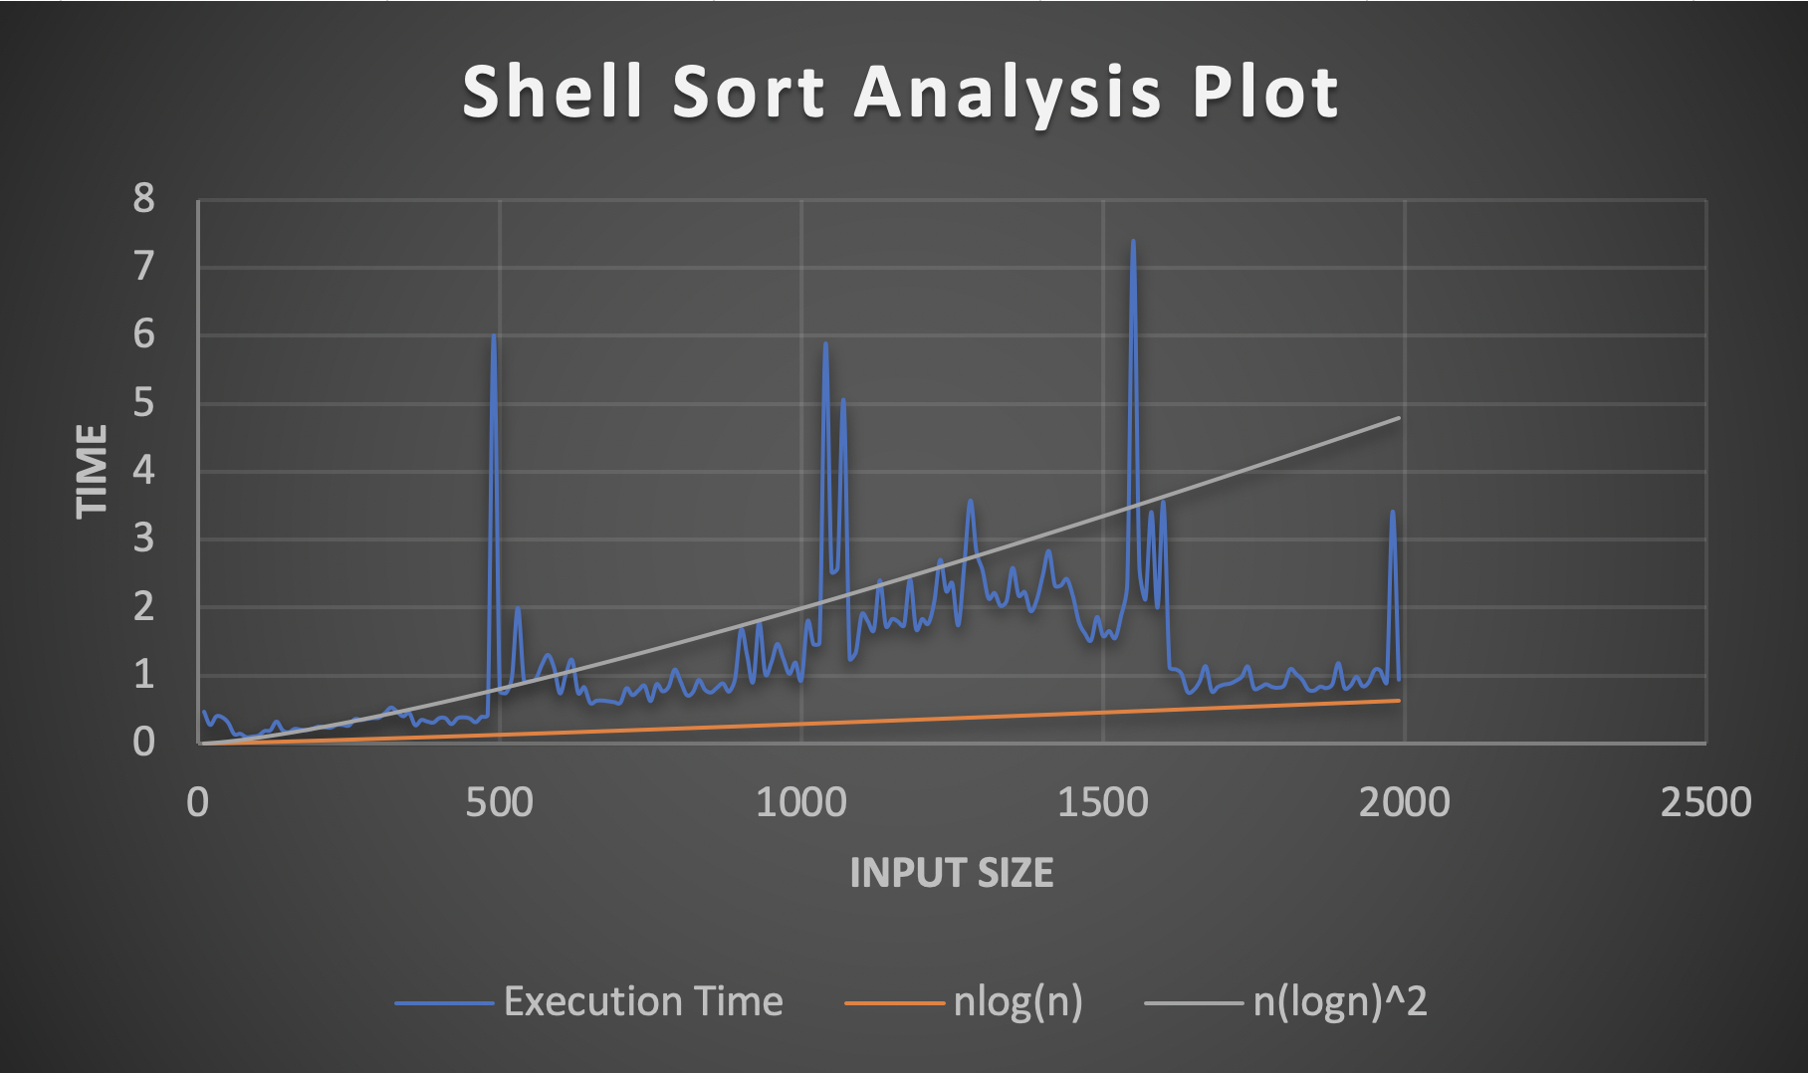
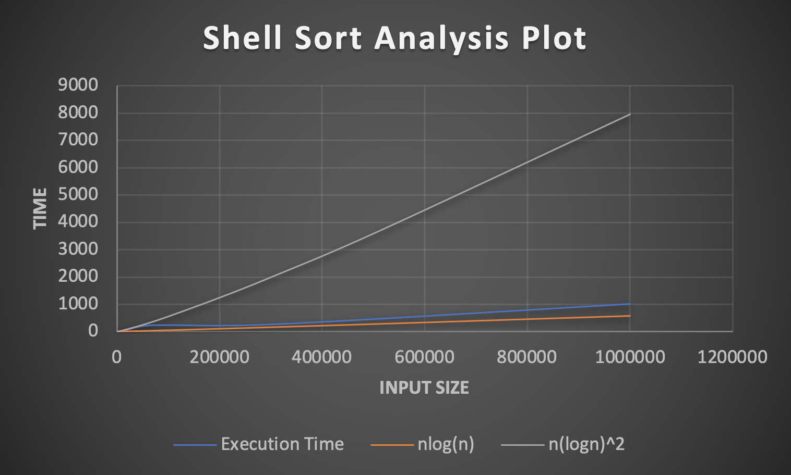
Shell sort analysis

Slide 10
02
TREE SORT

Slide 11
AN OVERVIEW
Tree Sort is an algorithm based on Binary Search trees
It can be used when the input sequence is received dynamically
Similar to quicksort in recursive partitioning
Not an in-place algorithm

Slide 12
5 | 4 | 7 | 2 | 11 | 14 | 6
5
Step 1:
Build a Binary Search tree (BST) from the sequence of input elements
4
7
2
6
11
14

Slide 13

5
Step 2:
Perform an inorder traversal on the BST to get the sorted sequence
4
7
2
6
11
14
2
4
5
6
7
11
14

Slide 14
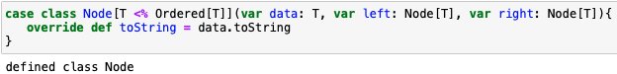
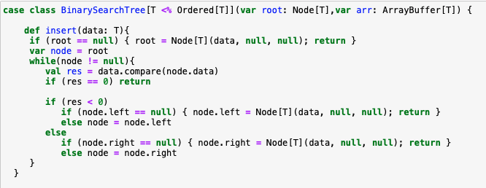
Tree sort code

Slide 15
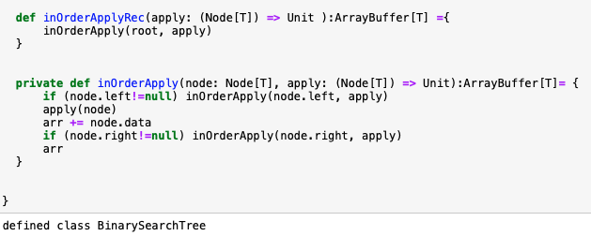
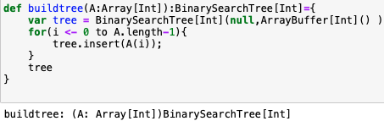

Slide 16
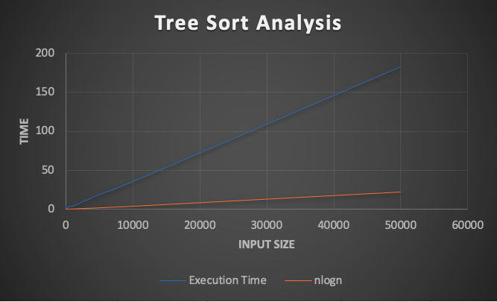
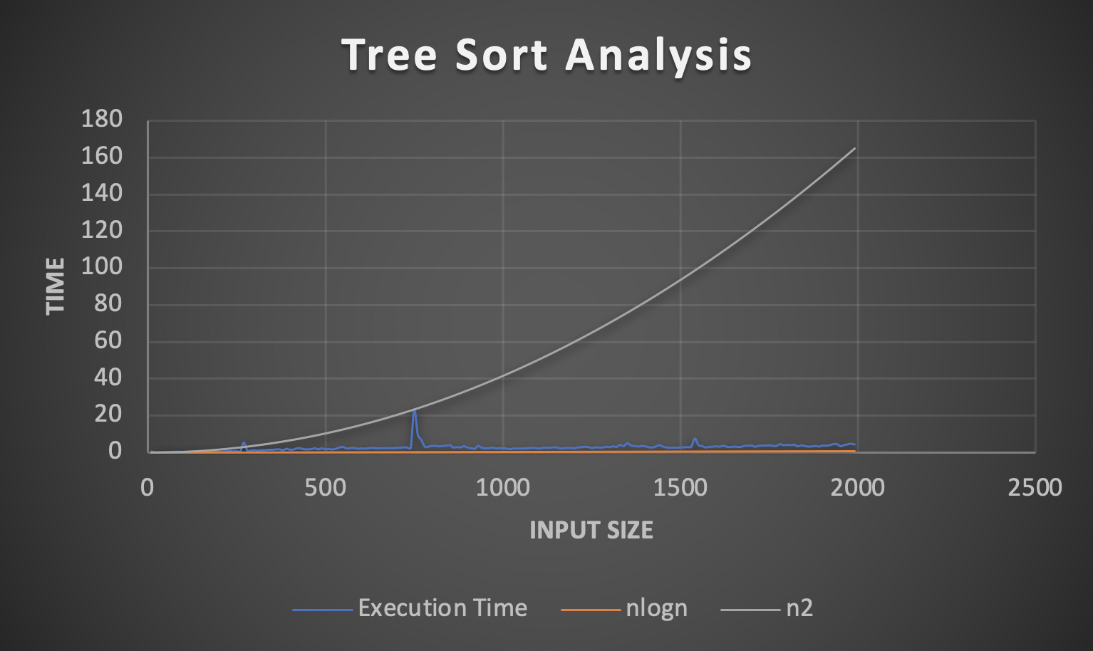
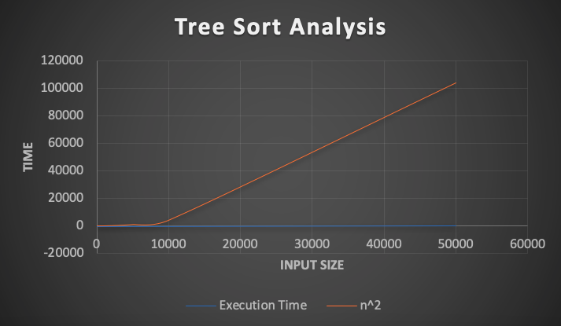
Tree sort analysis

Slide 17
03
HEAP SORT

Slide 18
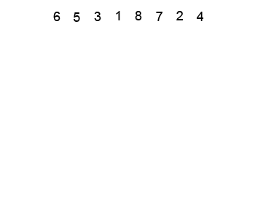
HEAP SORT
Heap sort is a comparison-based sorting technique based on Binary Heap data structure.
It is similar to selection sort where we first find the minimum element and place the minimum element at the beginning. We repeat the same process for the remaining elements.

Slide 19
ALGORITHM
The Heap sort algorithm to arrange a list of elements is performed using following steps
Construct a Binary Tree with given list of Elements.
Transform the Binary Tree into Max Heap.
Delete the root element from Max Heap using Heapify method.
Put the deleted element into the Sorted list.
Repeat the same until Max Heap becomes empty.
Display the sorted list.

Slide 20
WORKING
4
10
3
5
1
4
4 < 10
Swap!
10
3
4 < 5
Swap!
5
1

Slide 21
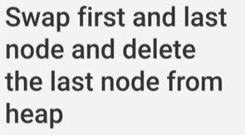
WORKING
10
5
3
4
1
3 > 1
Max Heap!
10
1<4
Swap!
1 < 5
Swap!
THE ARRAY IS SORTED!
5
3
1 < 4
Swap!
4
1

Slide 22
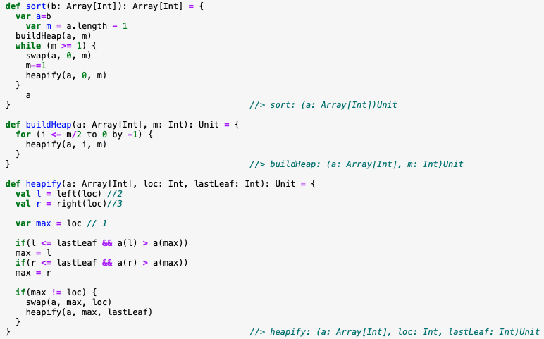
Heap sort code

Slide 23
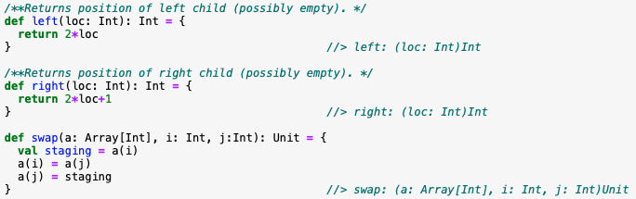

Slide 24
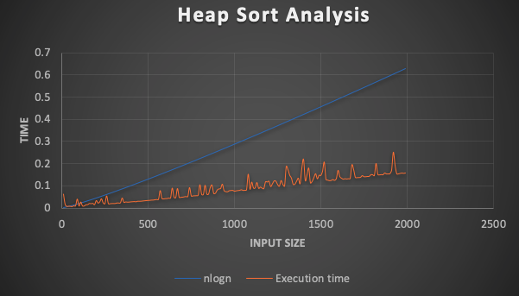
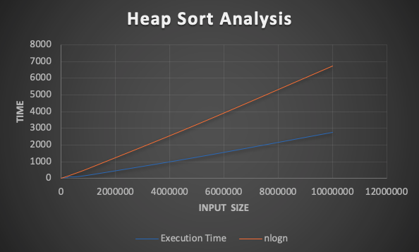
HEAP SORT ANALYSIS

Slide 25
04
Genetic Algorithm for tsp
Solving the Travelling Salesman Problem using Genetic Algorithm

Slide 26
Steps involved in Solving a ‘GA’ problem
Representation
INITIAL POPULATION
Fitness function
selection
CROSSOVER
Mutation
Representing the TSP problem.
Generating a random initial population.
Quantifying the fitness of an individual
Process of selecting fitter individuals
Recombination of two parents to generate offspring
Probabilistic process that ensures genetic diversity

Slide 27
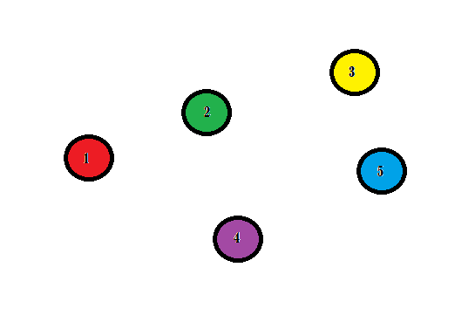
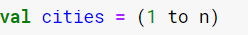
Representation of the problem
To represent the solution, we have taken list of integers representing the different cities.
For example, to represent a total of five cities we take a List as follows:
A = List( 1,2,3,4,5)
CODE :

Slide 28
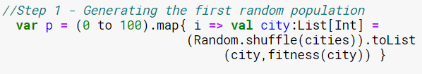
Initial population
Population: route traversed by the salesman.
Population size = 100.
We generate the initial population by randomly shuffling the list of cities.
We also map the fitness of each individual generated along with itself.
The above is stored as the first generation.
Example of Routes generated :
1 → 2 → 4 → 3 → 5
2 → 3 → 5 → 4 → 1
5 → 4 → 2 → 3 → 1
3 → 5 → 4 → 2 → 1
4 → 1 → 2 → 3 → 5

Slide 29
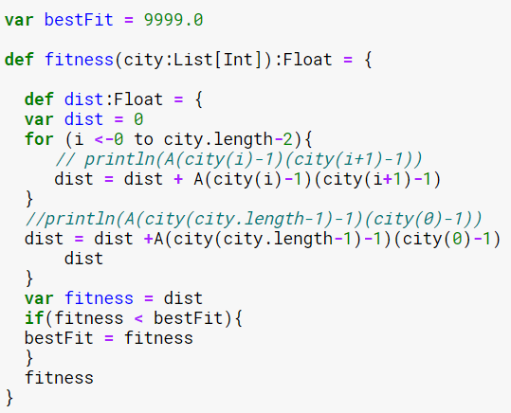
Fitness Function
Input → Candidate solution
Output → How good the solution is
Computation of fitness should be fast
The best fitness value is stored after every fitness evaluation
Fitness Computation: -
Total distance = dist + Adj [currentcity][nextcity]
Fitness = calculated distance
In our case, fitness = distance, therefore the lower the fitness the better the solution

Slide 30
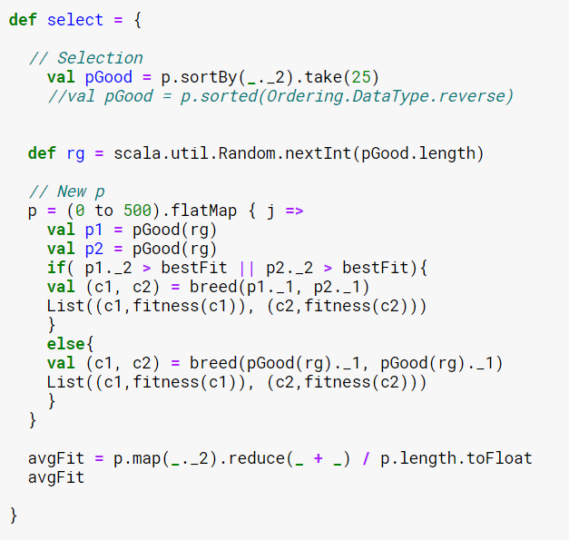
Selection
Selection is the stage in which individual genomes are chosen from a population for later breeding
Fitter individuals are taken for producing the offspring
In our case, the lower the fitness, the fitter the solution
We sort the population in ascending order and pick first 25
Selected ones are passed further for breeding
The average fitness for the current generation is also calculated

Slide 31
CROSS-OVER
C1 POINT = 2
PARENT1 =
1
3
4
2
5
3
2
4
1
5
PARENT2 =
CHILD =

Slide 32
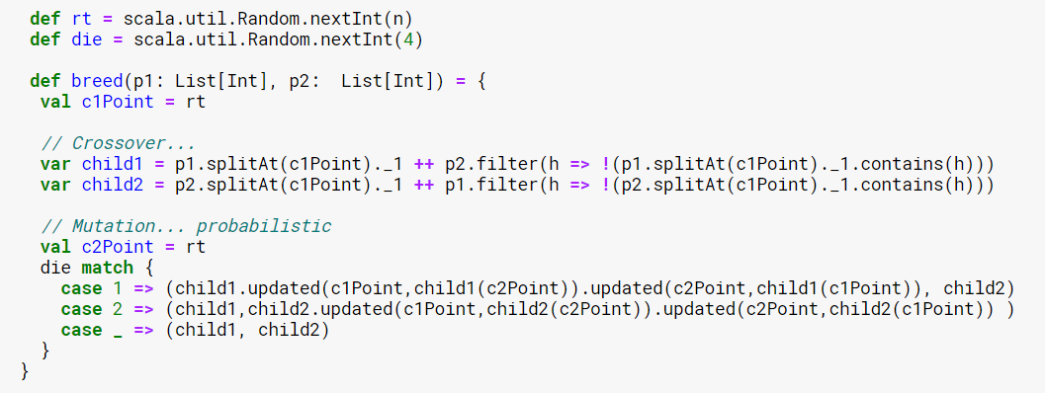
MUTATION
3
2
4
1
5
CHILD =

Slide 33
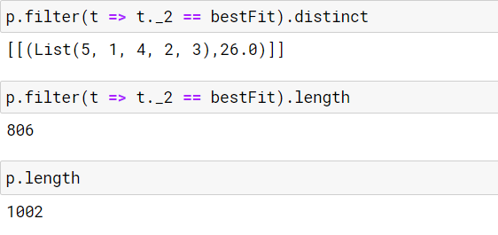
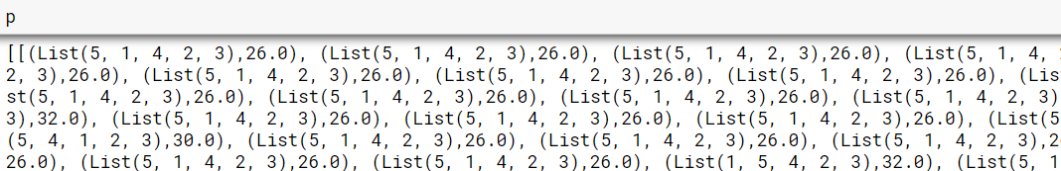
OUTPUT:

Slide 34
THANKS!

